Slide 1

Impact of COVID-19 On Economy
Hiremath, Abhishek Shivaprakash ash605
Sizhong Rao sr5374
Shuang Wu sw4211
Duo Xu dx478
Tianzi Zhao tz1125

Slide 2
Agenda
Introduction
Impact of Covid-19 on economy
Data collection
Data cleaning and truncating
Inflation rate (CPI) and share price
Basic analysis.
Principal Component Analysis ( PCA)
Clustering
Regressions and classification on COVID-19 and economics.
ROC-AUC curve
Prediction (ARMA test & VAR projection )
Conclusions

Slide 3

Introduction
The World Health Organization (WHO) first declared COVID-19 a world health emergency in January 2020.
COVID-19 pandemic is having a noticeable impact on global economic growth.
Estimates so far indicate the virus could trim global economic growth by as much as 2.0% per month .
With the uncertainty lying behind COVID-19, we can expect the global market to be quite volatile with no global growth this year.
According to the Organisation for Economic Cooperation and Development (OECD), 2020 can see an estimated 2.4 per cent decline for the global economy before a growth of 3.3 per cent next year

Slide 4
Data Collection
Collected data from Our World in Data.
Our complete COVID-19 dataset is a collection of the COVID-19 data maintained by Our World in Data. It is updated daily and includes data on confirmed cases, deaths, and testing.
Economic data is gathered from OECD and also Gapminder.
Two important metric we will be focusing on —— inflation rate and the share price.

Slide 5
Data Cleaning
Only keeping location,date,total_cases,total_deaths,case per million, death per million as useful columns for the prediction.
Check for Null values and drop the columns since it will create a bias in the prediction.
Importing the datasets from Gapminder for inflation rate and GDP.
Data from all the countries with most effected by the COVID-19.
Filter to pick five counties with most cases(online research).

Slide 6
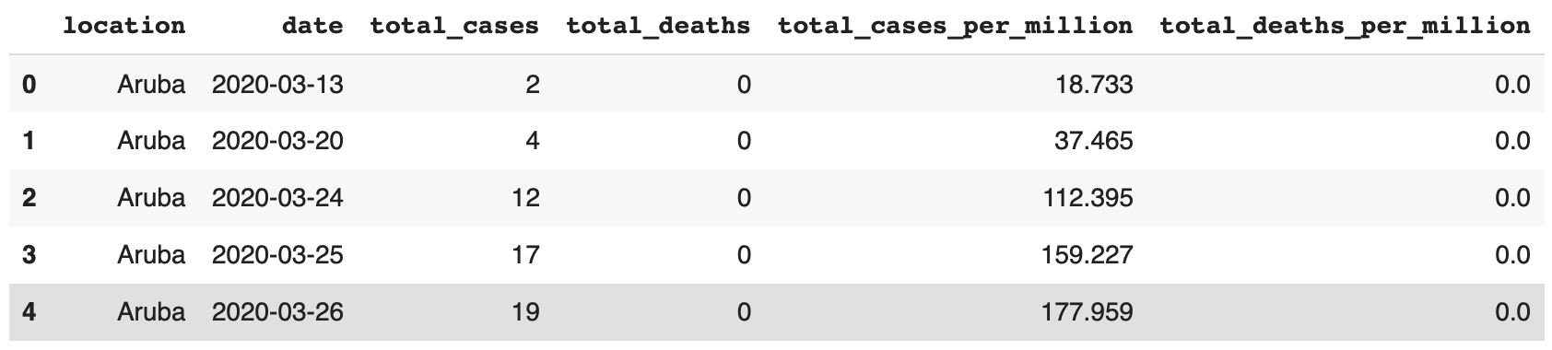
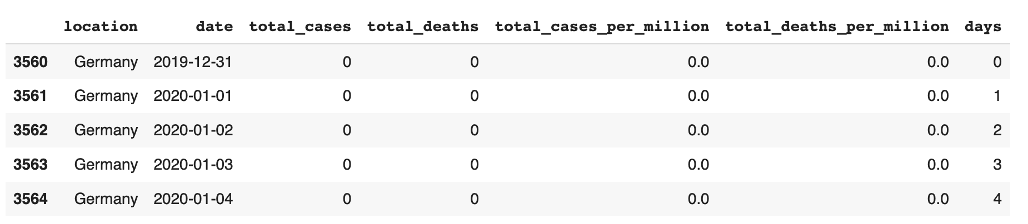
Sanity Check

Slide 7
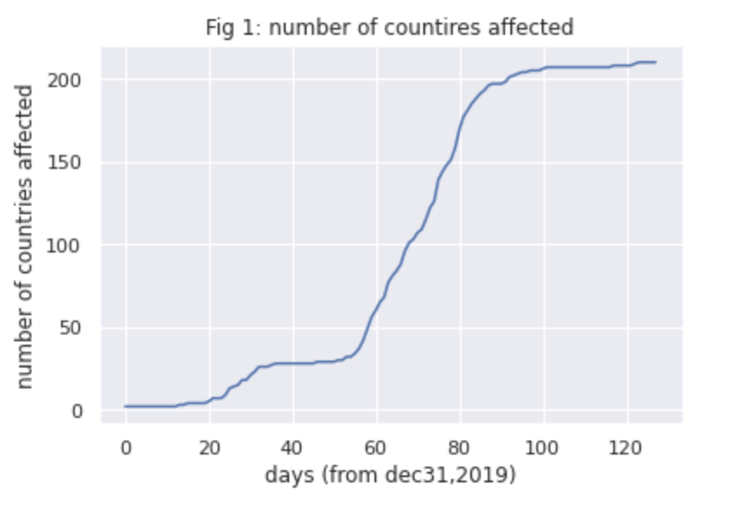
Basic Analysis
Count of affected countries from december 2019

Slide 8
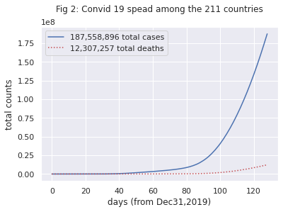
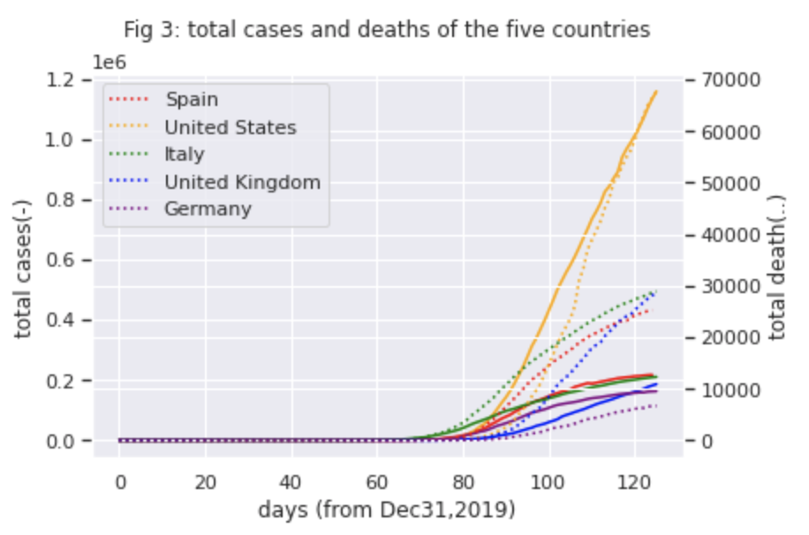
Basic Analysis
Scatter plot of the five countries with the total number of cases and total death.

Slide 9
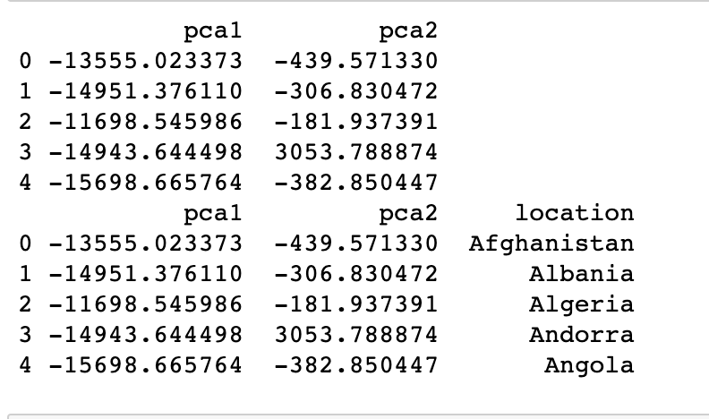
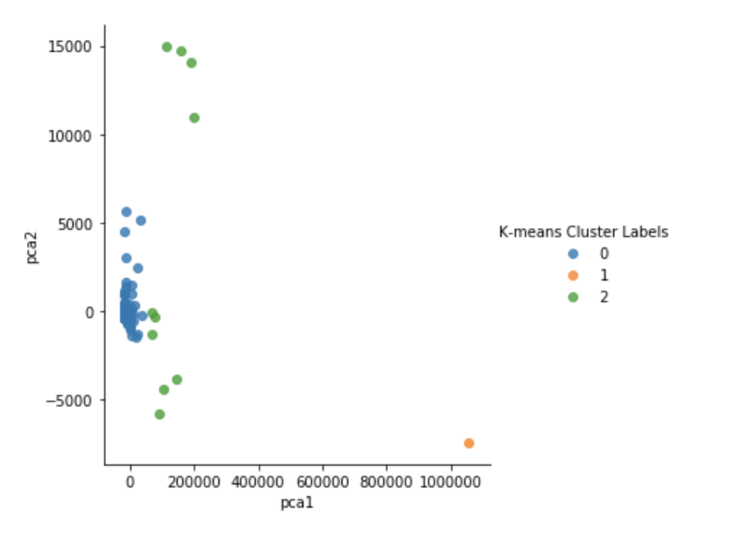
PCA and Clustering
All countries are divided into three categories by k-means.
orange dots ---- The United States (the country with the highest number of infections)
green dots ---- remaining countries with high numbers of infections
blue dots ---- remaining countries with low numbers of infections

Slide 10
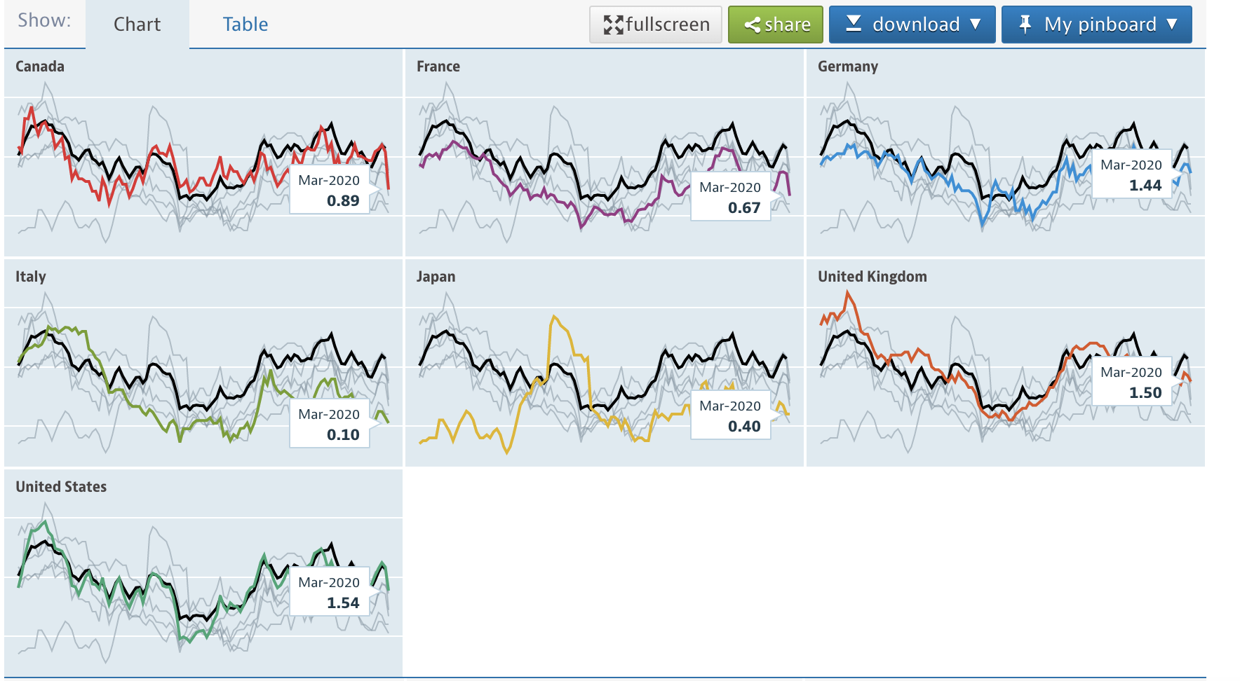
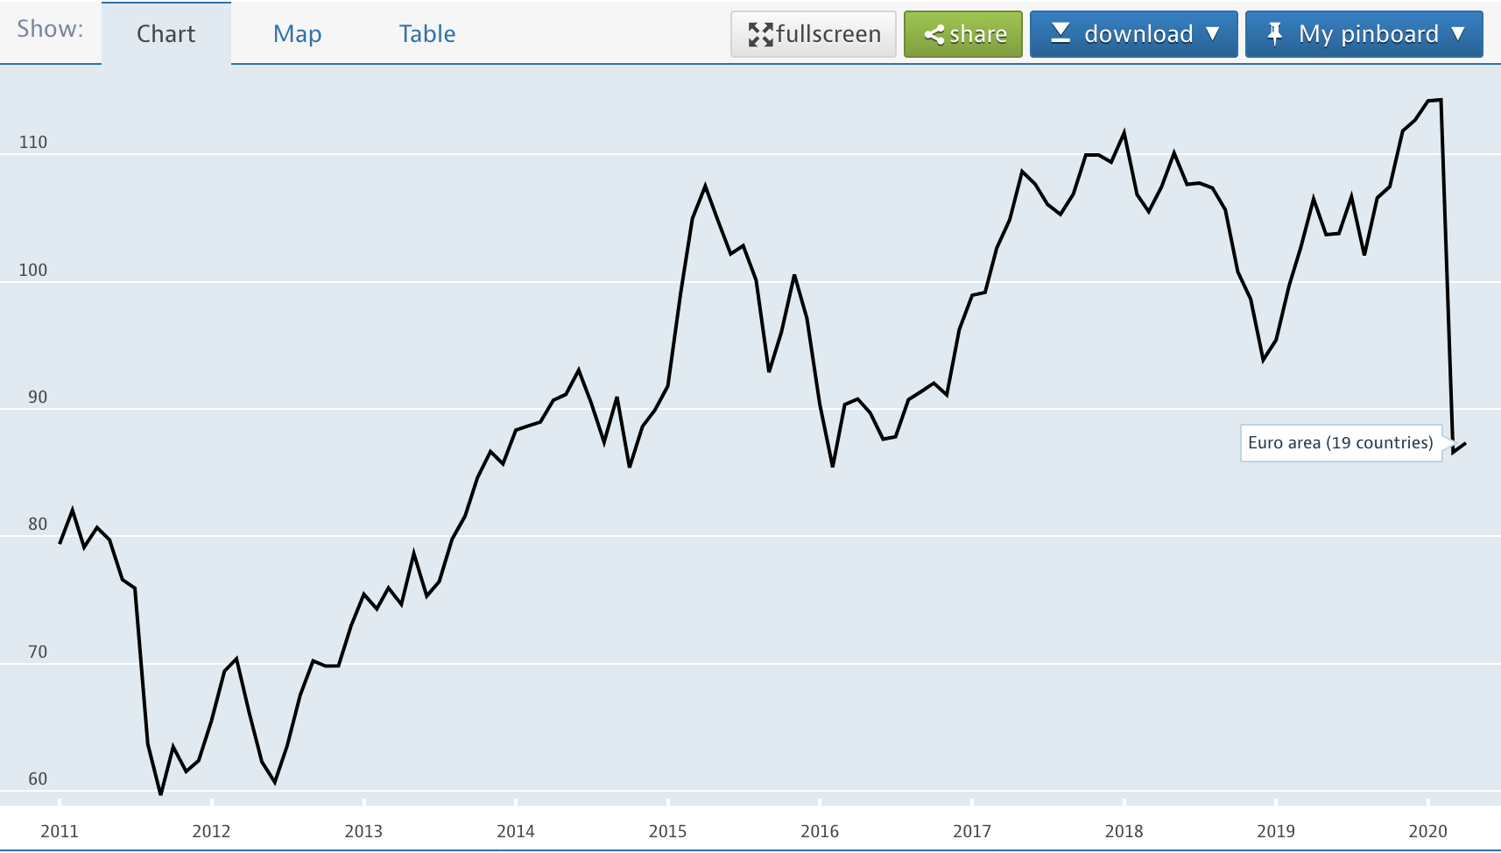
Definition
Inflation rate (CPI):
Inflation measured by consumer price index (CPI) is defined as the change in the prices of a basket of goods and services that are typically purchased by specific groups of households. Inflation is measured in terms of the annual growth rate and in index, 2015 base year with a breakdown for food, energy and total excluding food and energy.
Share price:
Share price indices are calculated from the prices of common shares of companies traded on national or foreign stock exchanges. They are usually determined by the stock exchange, using the closing daily values for the monthly data, and normally expressed as simple arithmetic averages of the daily data.

Slide 11
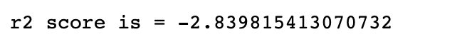
Regression and Classification
Linear regression
x1 = 'new_case_rate', x2 = 'death_rate', y =’ inflation_rate’
Lasso regression
Ridge regression
Explanation
The results (r score) from linear regression, lasso regression and ridge regression are all negative, so the model does not fit.

Slide 12
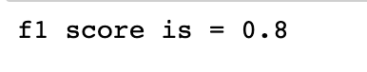
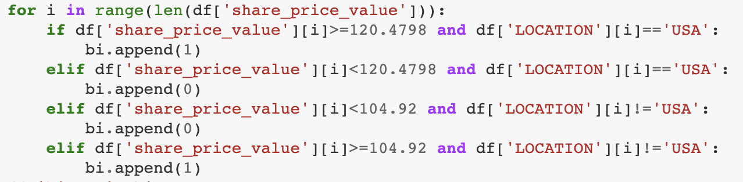
Logistic Regression
Set a binary before we do regression:
European 19 countries' share price in 2019 is 104.92 and USA is 120.4798.
x1 = 'new_case_rate', x2 = 'death_rate', y =’ share_price_value’
If the outcome returns more 1 than 0, it shows COVID-19 do not have significant negative influence on the economy because share price is going high; If the outcome returns more 0 than 1, then the the impact is significant. Here is our outcome: [1 0 0 1 0]
So, COVID-19 has significant negative influence on the economy.
More explanation
Since the results (f score) from logistic regression is 0.8, close to 1, so this model has high accuracy.

Slide 13
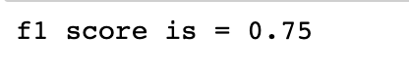
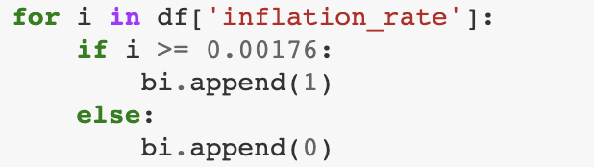
Logistic Regression
Set a binary before we do regression:
World inflation rate in 2019 was 1.76%.
x1 = 'new_case_rate', x2 = 'death_rate', y =’ inflation_rate’
More explanation:
Since the results (f score) from logistic regression is 0.75, close to 1, so this model has high accuracy.
If the outcome returns more 1 than 0, it shows COVID -19 has negative influence on the economy because inflation rate is high; If the outcome returns more 0 than 1, then the the impact is not negative. Here is our outcome: [1 1 1 1 0]
So, COVID-19 has negative influence on the economy.

Slide 14
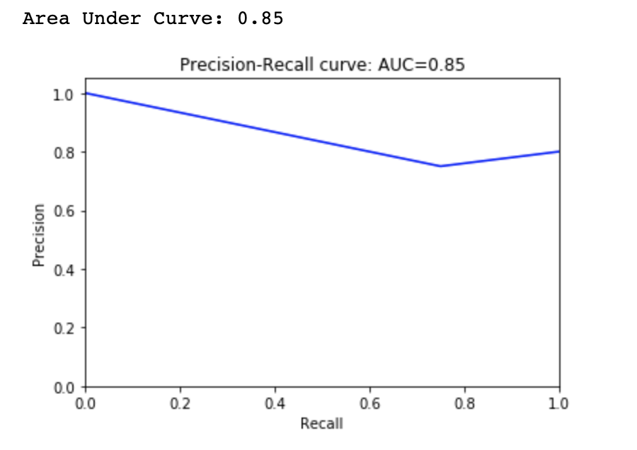
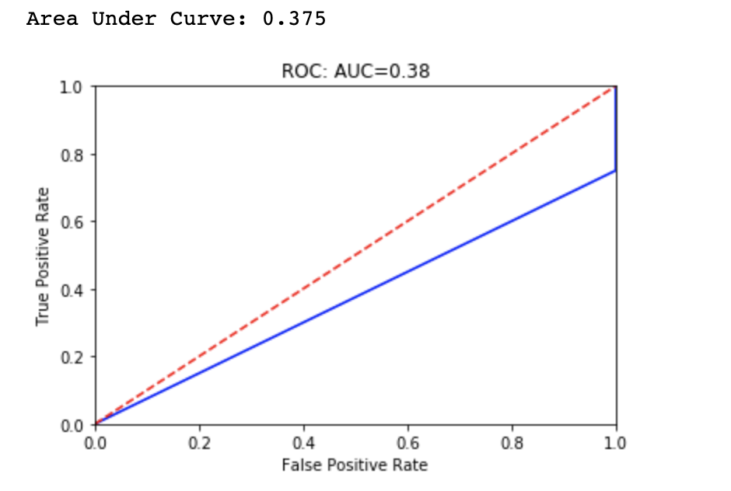
ROC-AUC curve
ROC-AUC curve can be used to judge the classification effect, above we can see two AUC number, 0.85 for “share price value”, 0.375 for “inflation rate”, so the accuracy of classification for “inflation rate” is not good.

Slide 15
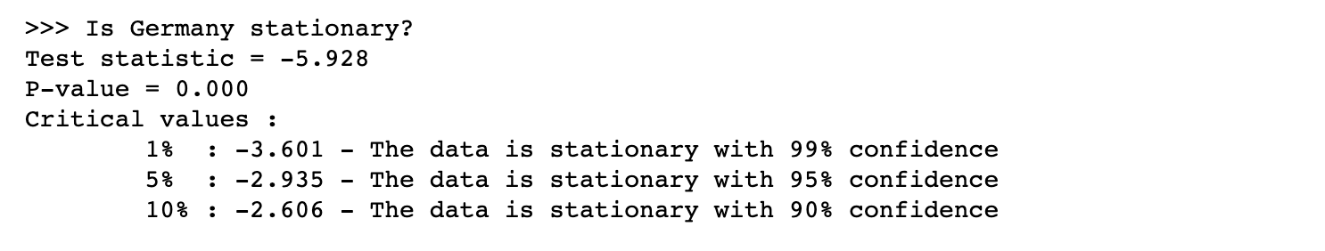
ARMA test
Prediction time series by ARMA test:
Explanation:
Since test statistic is negative and P-value is 0, the stationary test failed.
(see next slide

Slide 16
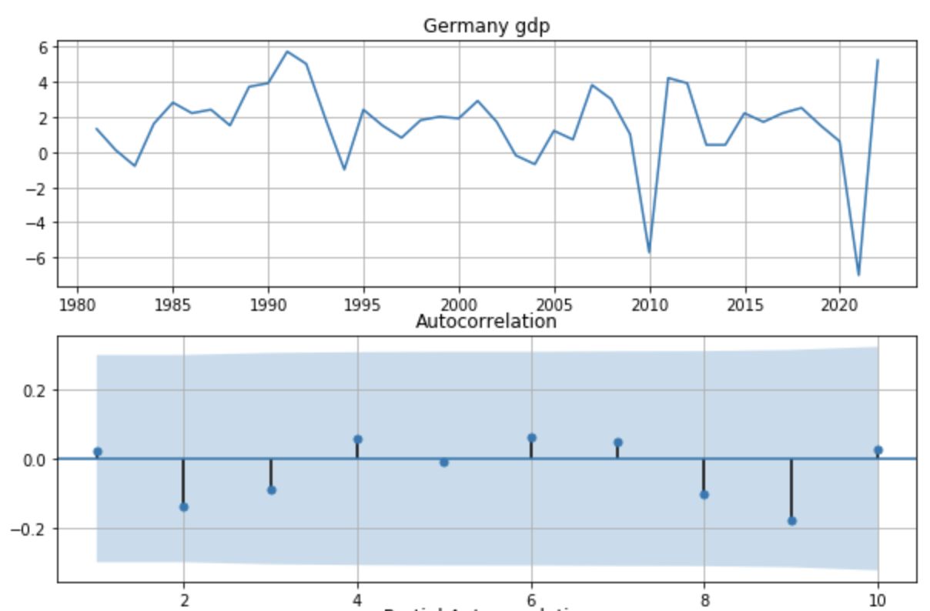
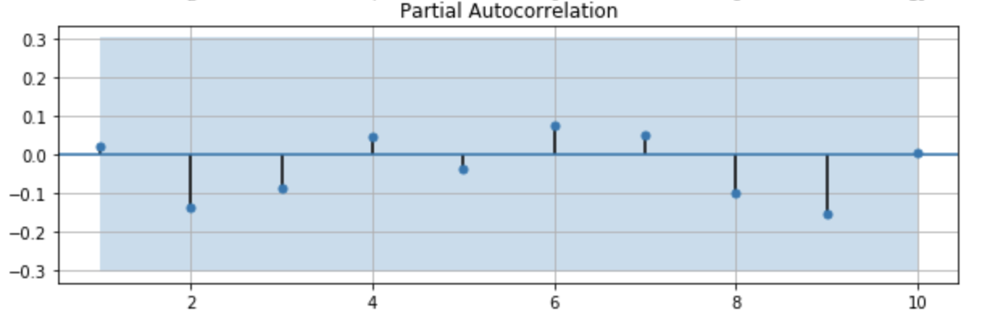
ARMA test
Prediction time series by ARMA test:
Explanation:
Got white noise so no way to predict by using ARMA.

Slide 17
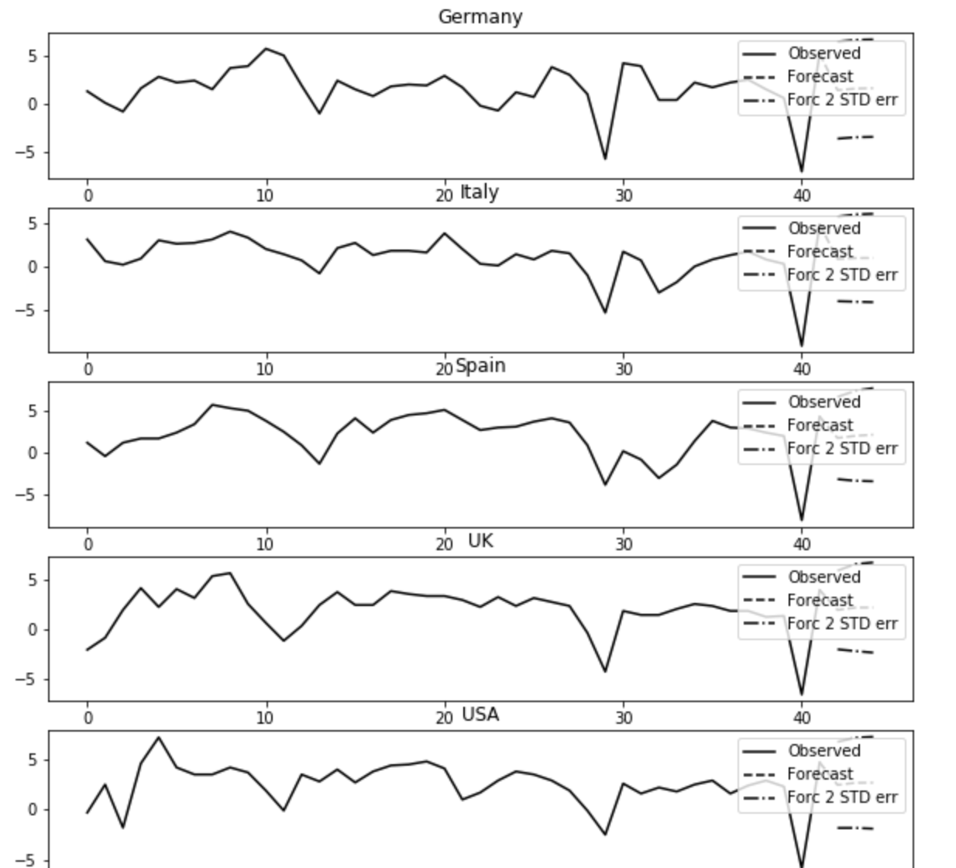
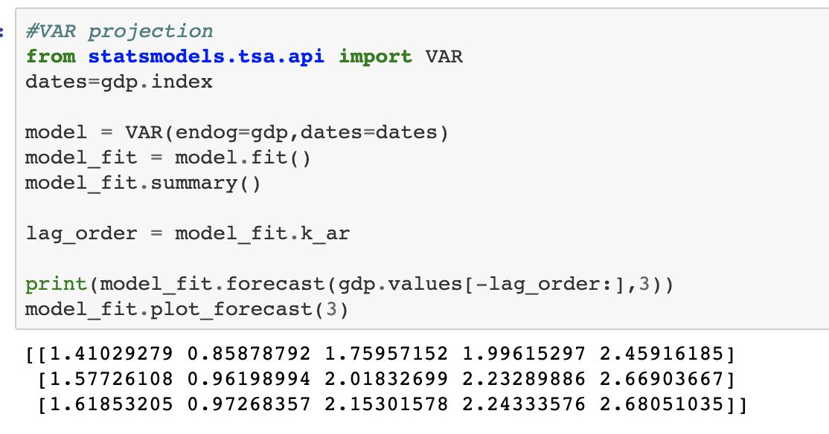
VAR projection
Prediction time series by VAR:
The x-axis is the year, 0 is 1980s, and 10 is 1990s, etc.
The dashed line after 40 is the forecast after 2020.

Slide 18
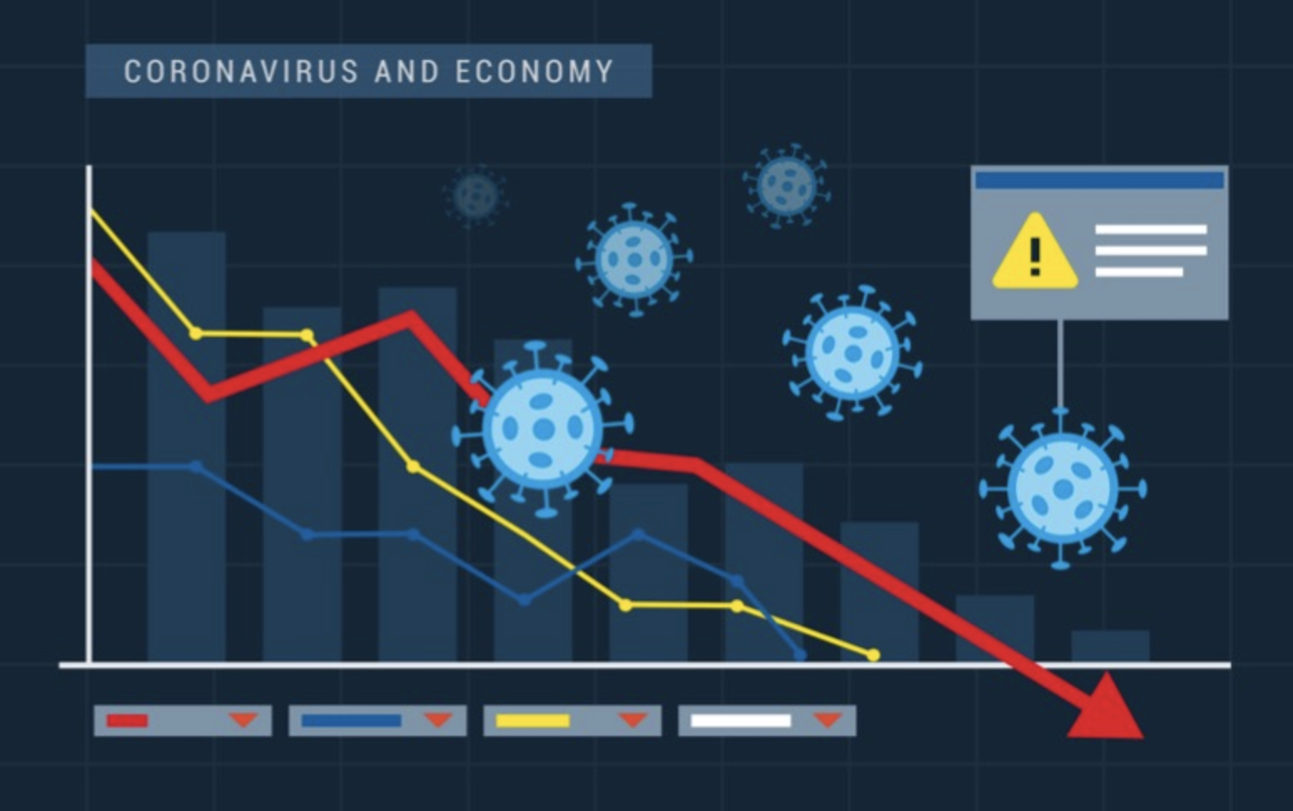
Conclusion
Logistic regression model fits this case well.
From the above results of two index: “new_case_rate” and “death_rate” , we conclude that Covid19 affects the economy by affecting share prices and inflation.
GDP in Germany, Italy, Spain, the United Kingdom and the United States will continue to grow after the trough of covid 19 (after 2020).

Slide 19
Thank you.

